Slide 1
File I/O
Creative Commons Attribution-NonCommercial-ShareAlike 3.0 Unported License. http://creativecommons.org/licenses/by-nc-sa/3.0/
Written by Rachel J. Morris, last updated 2016-02-08

Slide 2

Input & Output
Streams

Slide 3
cin and cout
We've been using streams to get input and output already, via the cin and cout commands.
There are also ifstream and ofstream objects that we can use to stream out-of and in-to text files.
If it's a text format file we can write it out easily --

Slide 4
cin and cout
We've been using streams to get input and output already, via the cin and cout commands.
There are also ifstream and ofstream objects that we can use to stream out-of and in-to text files.
If it's a text format file we can write it out easily --
.csv
.txt
Even .cpp
If you really wanted to...
.html

Slide 5
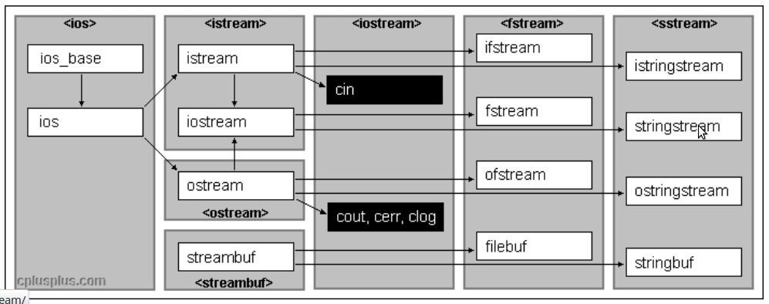
cin and cout
cin and ifstream are part of the same family,
as are cout and ofstream.
From http://www.cplusplus.com/reference/iolibrary/

Slide 6
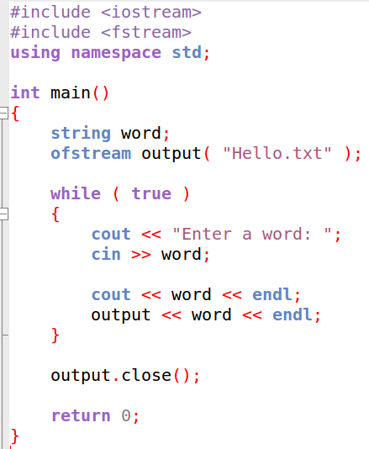
ifstream and ofstream
To use ifstream (input-file-stream)
and ofstream (output-file-stream)
You need to
#include <fstream>
Then you can declare an object of type ofstream or ifstream.

Slide 7
ofstream
Outputting to a text file looks similar to outputting to the screen, except to write to the screen we use
cout << "Text";
But with our file stream, we use the file object that we've created.
outputFile << "Text";
We declare a ofstream variable, and pass in a file name to open.
We also need to make sure to close the file once we are done with it.

Slide 8

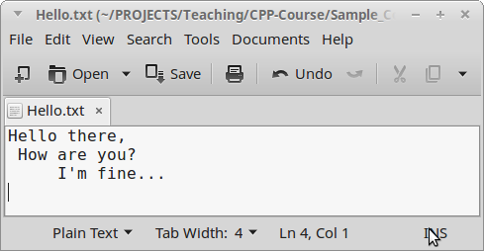
ofstream
We can also use endl with our file output stream, as well as \t and \n.
Then we'll just get a simple text file:

Slide 9
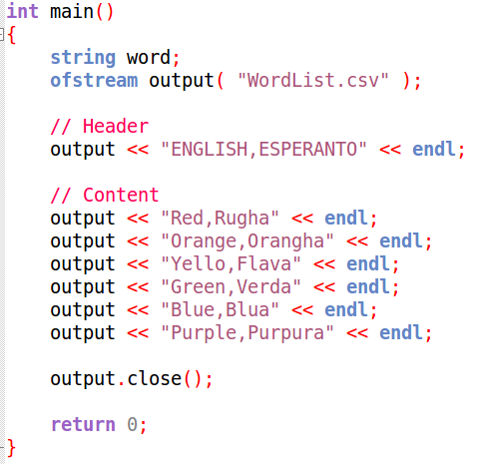
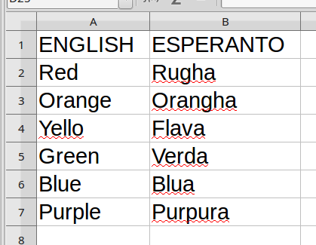
ofstream
But we can also output other file formats, if we follow that file's standards:
CSV (comma-separated-value) files can be opened in Excel or LibreOffice:

Slide 10
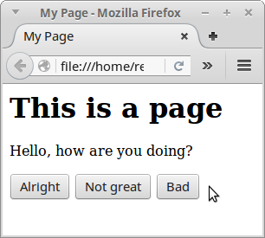
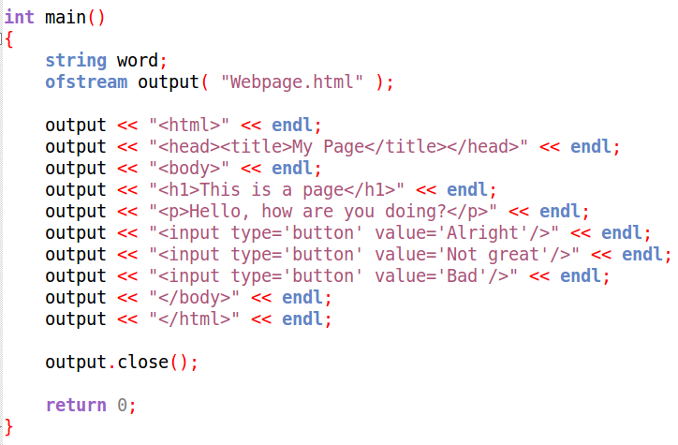
ofstream
Many file types are just plaintext if you open them up in notepad or something similar...

Slide 11
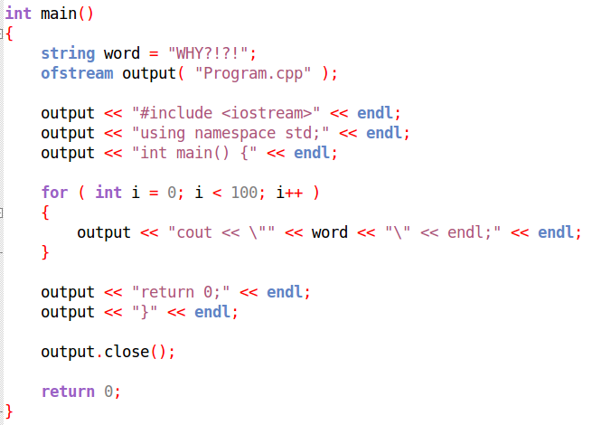
ofstream
You could even do this if you really wanted to...

Slide 12
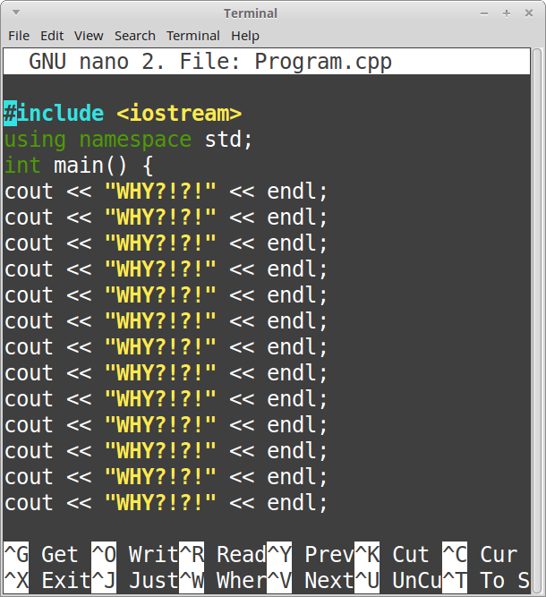
Which creates another .cpp file...

Slide 13
ifstream
On the flip side, you can use ifstream to read in a text file.
You can load any plaintext file, just like the ones we wrote out, but actually reading them is a little more difficult.
Once you load in the file, you have to know how to parse it, to get useful information out for your program to use.
(That means, you have to write the logic on how to actually read the file or find a library that does it for you!)

Slide 14
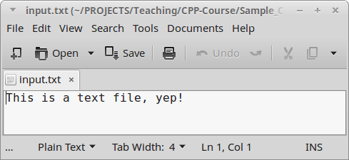
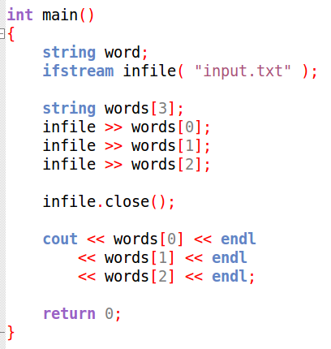
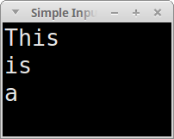
ifstream
Input text file
Program code
Program output

Slide 15
ifstream
Similar to using cin to get input from the user to store into a variable, we can use the ifstream variable to load text from a text file into variables.
Program code
But we need to declare an ifstream object, open a text file, and make sure to close it at the end.

Slide 16
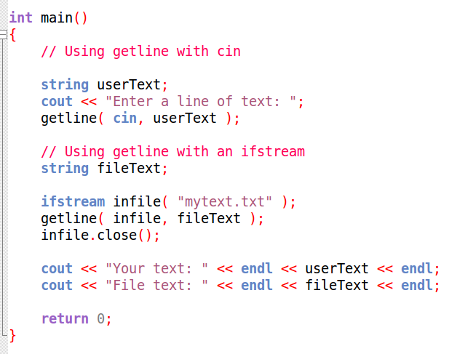
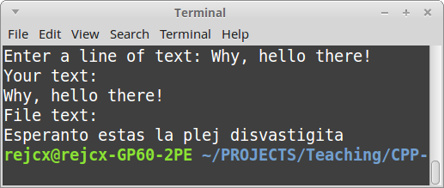
ifstream
Just like we can use the getline function to get a line of text from the user (keyboard), we can use getline on an ifstream object to get a line of text from a file.

Slide 17
ifstream
Why might you want to read a text file?
To store data when your program closes, so you can resume with the same information later!
To analyze text files on a system!
To read in a file, add formatting, and write it back out!
To read in a set of commands to execute!

Slide 18

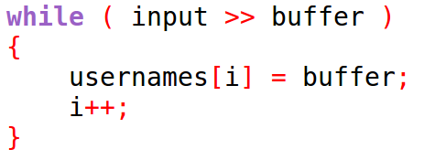
ifstream
Also...
You can use the stream operator to store text from a file in data-types like strings, ints, floats, and any others that support input from streams – just line cin.
Read every word of the file until there are no more words to read.
You can also keep loading in one word at a time
(delimited by whitespace – spaces, tabs, new lines, etc.)
until the end of the file with a while loop like this.

